Slide 1
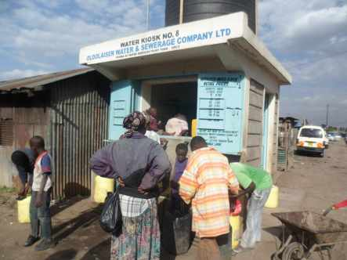
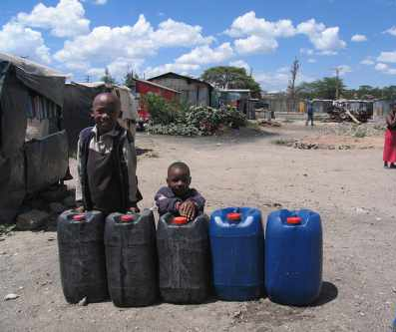

Water Sector Trust Fund

Slide 2

Mandate of the Water Sector Trust Fund
The Water Sector Trust Fund (WSTF) is a State Corporation, established under the Water Act 2016, with the objective to provide conditional and unconditional grants to the Counties, and to assist in financing the development of and management of water services in the marginalized and underserved areas.
There are 4 Financing mechanisms:
The Rural Investments – an investments programme for rural water and sanitation projects.
Water Resources Investments – to improve management of water resources and water catchments in Kenya.
Urban Project Concept (UPC) – funding of water supply and sanitation service projects in low income urban areas
Result Based Funding (RBF) comprising Aid on Delivery (AoD and Output Based Aid (OBA) facilities.

Slide 3
Current Status of the Water Sector in Kenya
Framework
Modern institutional framework, separating policy – regulation – service provision
Right to water and sanitation enshrined in the constitution 2010
New Water Bill responding to devolution currently awaiting presidential ascend to law.
Challenges
Almost 50% of the population are still lacking access to adequate water supply, 40% to adequate sanitation (Maji data)
60% - 80% of all diseases are related to inadequate water supply and sanitation
Significant lack of funding to extend services to the unserved urban areas.
Continuing growth of urban low income areas in Kenya.

Slide 4
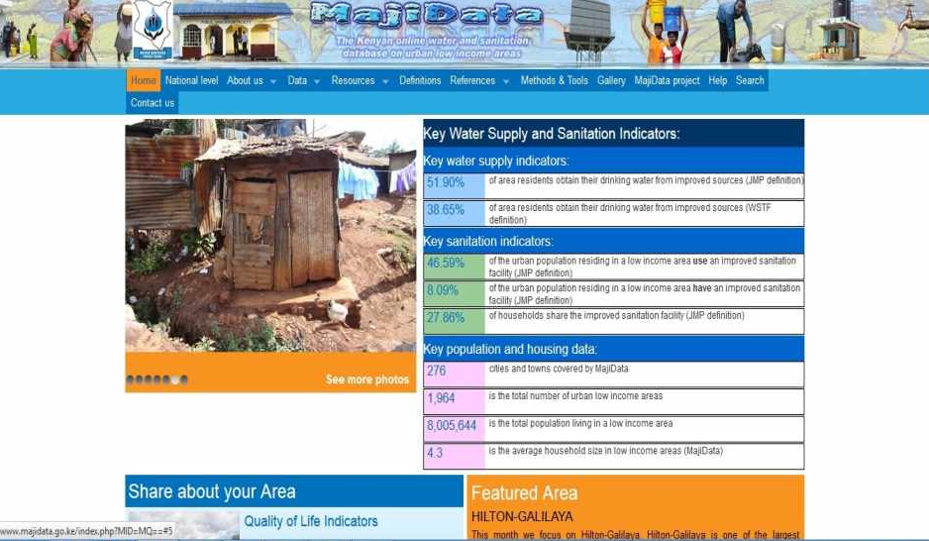
Maji Data (www.majidata.go.ke)

Slide 5
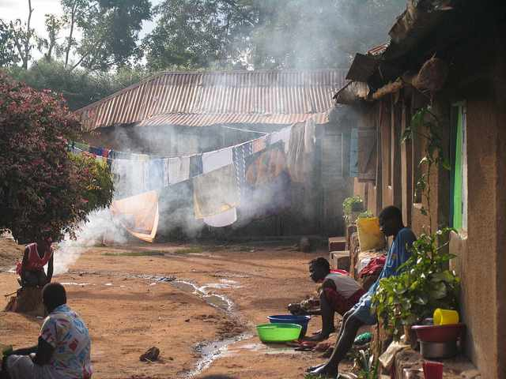
The Urban Challenge

Slide 6
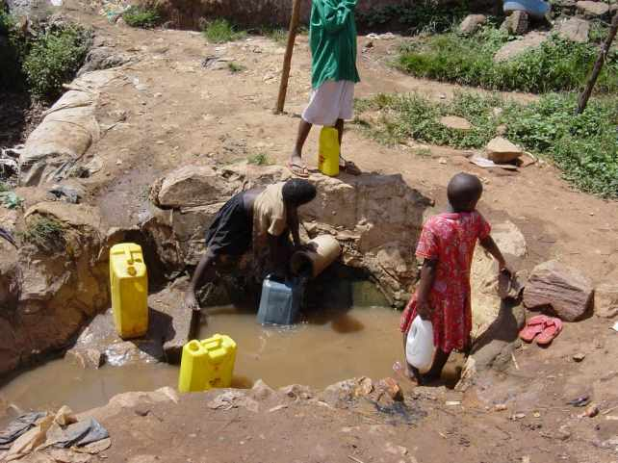
Almost 50% of the population in urban areas have no access to adequate water supply but depend on “alternative sources”

Slide 7
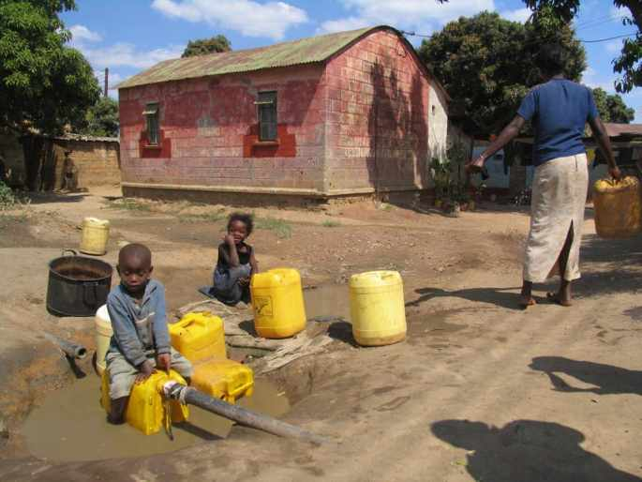
Women and children are particularly affected

Slide 8
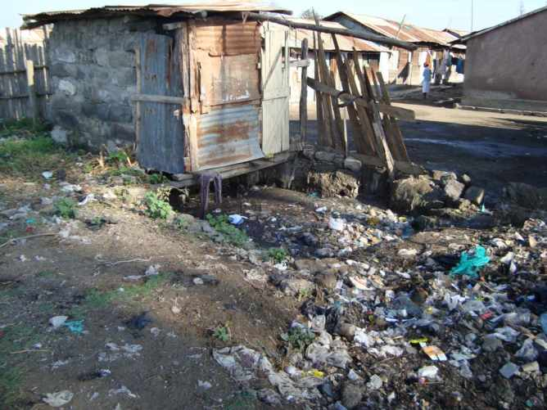
Approx. 40% of the urban population have no adequate toilets, leading to significant risks for public health

Slide 9
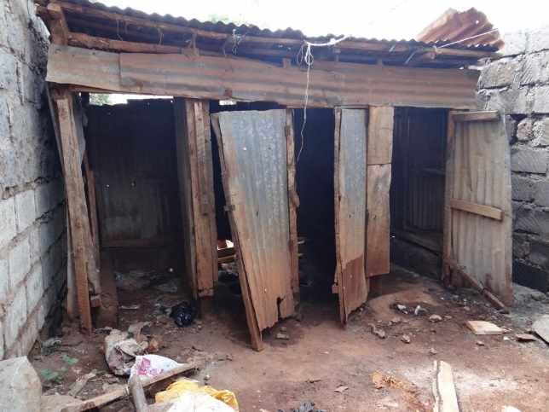
Although landlords are required by law to provide adequate toilets, existing toilets often do not provide for privacy and hygienic use

Slide 10
Water Sector Trust Fund supports in urban areas
Approx. 100 urban water supply and sanitation companies are eligible for WSTF funding
Projects are granted through competitive process, based on transparent criteria and a data base which has mapped 2.000 low-income areas (MajiData)
So far, 7 calls for water supply and 1 call for household sanitation (UBSUP) have been made
70 water utilities have implemented 236 WSTF projects
1,8 Mio. people benefited from improved water supply and sanitation
The up-scaling project for household sanitation (UBSUP) is one of the biggest world-wide

Slide 11




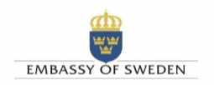







KEY DEVELOPMENT PARTNERS
IFAD
INTERNATIONAL FUND FOR AGRICULTURAL DEVELOPMENT

Slide 12
Progress
W: 1.5 mio
S: 284,000
W: 1.7 mio
S: 292,000
W: 980,000
S: 54,000
W: 1.4 mio
S: 100,000
1st Call: 2/2009 -4/2010
3rd Call: 8/2010 - 5/2011
4th Call: 5/2011 - 3/2012
5th Call: 12/2011 - 3/2013
2nd Call: 10/2009 - 9/2010
W: 685,000
S: 45,000
W: 430,000
S: 23,000
7th Call:
10/2015 -
ongoing
6th Call:
10/2013 -
7/2014
W: 180,000
W:
20,000
Financial volume of project investments
1st - 7th Call: approx. EUR 25 million
Up-scaling Basic Sanitation for the Urban Poor, UBSUP: reaching 400,000 people with household- & plot-level sanitation until 2017, at a cost of USD 20 million
Concept & Pilot: 2007/08

Slide 13
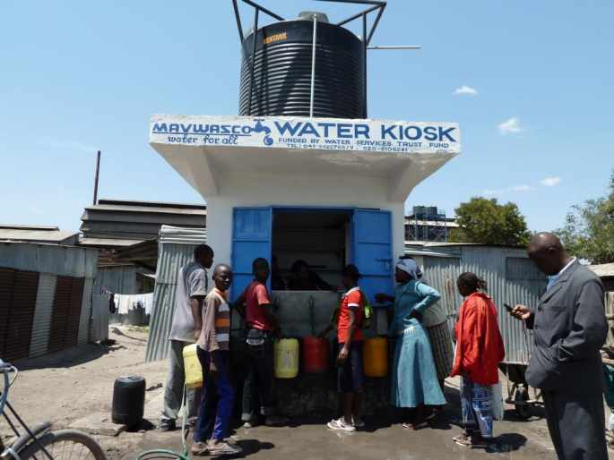
492 Water Kiosks

Slide 14
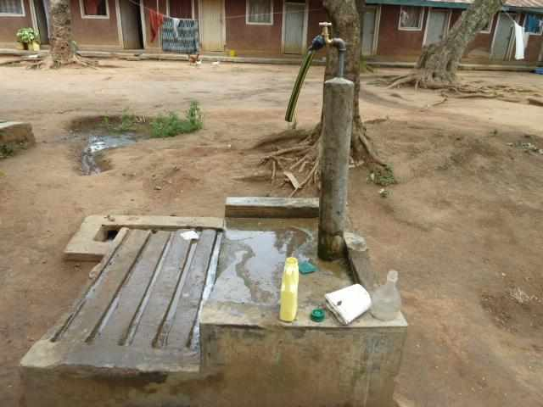
530 Yard Taps built

Slide 15
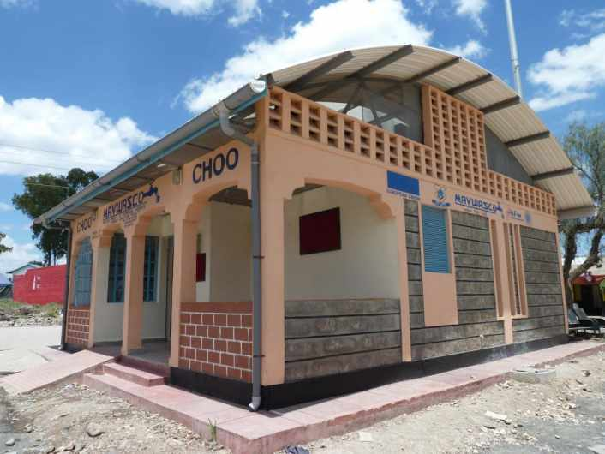
41 public sanitation facilities built

Slide 16
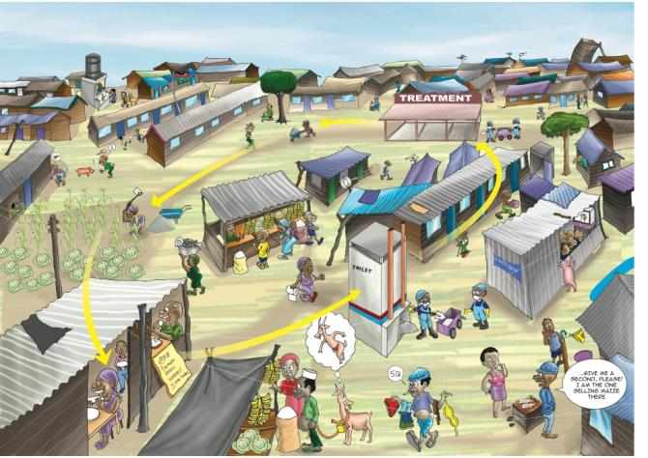
UBSUP ensures that the full sanitation value chain is covered

Slide 17
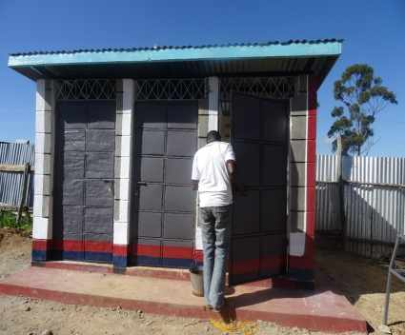
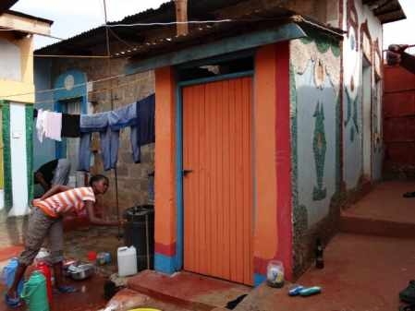
New or renovated household toilets

Slide 18
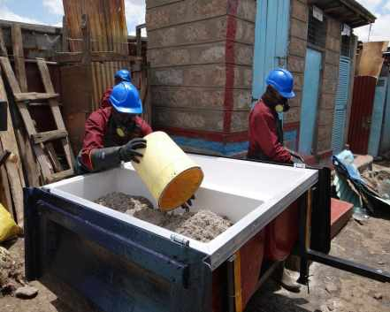
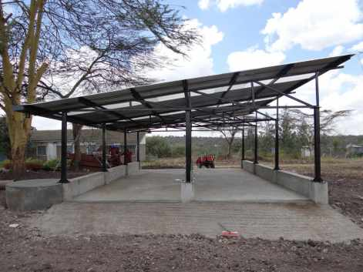
Sanitation teams and Decentralised Treatment Facilities (DTFs) established in participating towns

Slide 19

Thank You!

